Slide 1
Chapter : Analysis Modeling

Slide 2
Requirements Analysis
Requirements analysis allows the software engineer (called an analyst or modeler in this role) to:
Elaborate on basic requirements established during earlier requirement engineering tasks
Build models that depict user scenarios, functional activities, problem classes and their relationships, system and class behavior, and the flow of data as it is transformed.
Analysis model and the requirements specification provide the developer and the customer with means to assess quality once software is built.

Slide 3
Analysis Modeling Principles
Analysis methods are related by a set of operational principles:
The information domain of a problem must be represented and understood.
The functions that are software performs must be defined.
The behavior of the software must be represented.
The models that depict information, function and behavior must be partitioned in a manner that uncovers detail in a layered fashion.
The analysis task should move from essential information toward implementation detail.

Slide 4
Analysis Modeling Principles
Information domain encompasses that the data flow into the system, out of the system and data stored.
Functions provide direct benefit to end-users and also provide internal support for those features that are user visible.
Behavior driven by its interaction with the external environment.
E.g. Input provided by end-users, control data provided by an external system, or monitoring data.

Slide 5
Analysis Modeling Principles
Key strategy of analysis model, divide complex problem into sub-problem until each sub-problem is relatively easy to understood. This concept is called partitioning.
Implementation detail (design model) indicates how the essence will be implemented
E.g. Keyboard command might be typed or a joystick used.

Slide 6
Analysis Model Objectives
Three Primary Objectives:
Describe what the customer requires.
Establish a basis for the creation of a software design.
Devise a set of requirements that can be validated once the software is built.
Its bridges the gap between a system-level description that describes overall system functionality and a software design.
Guidelines :
Graphics should be used whenever possible.
Differentiate between the logical (essential) and physical (implementation) considerations.
Develop a way to track and evaluate user interfaces.

Slide 7
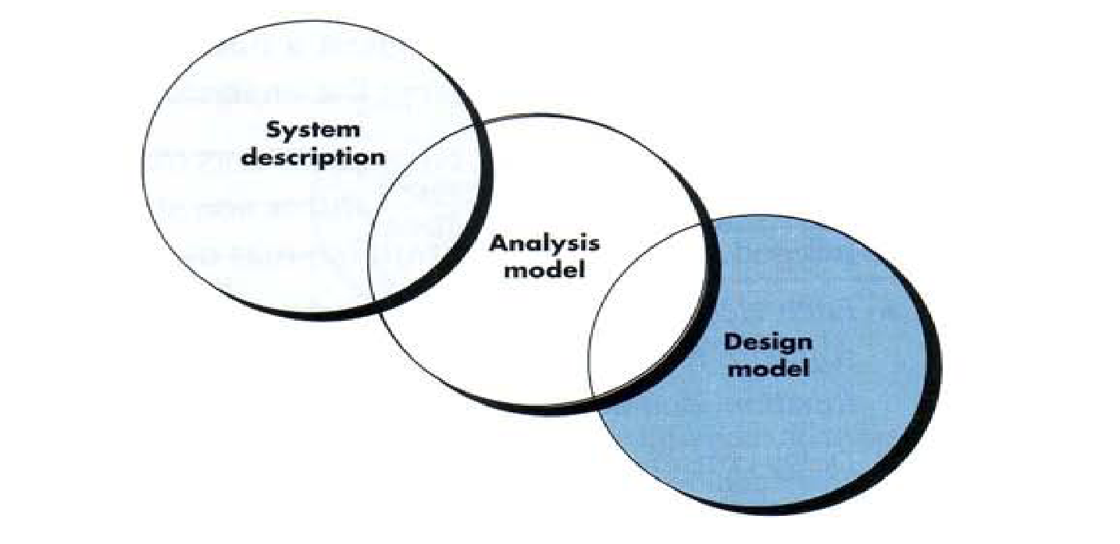
Analysis Model - A Bridge

Slide 8
Elements of Analysis model
There are two approaches
Structured Analysis:-
Data objects are modeled in a way that defines their attributes and relationships.
Processes that manipulate data objects in a manner that shows how they transform data as data objects flow through the systems.
Object Oriented Analysis :-
Focuses on the definition of classes and the manner in which they collaborate with one another.
UML is predominantly object oriented.

Slide 9
Structural Diagrams:
Represent the static aspect of the system means represent those parts of a diagram which forms the main structure and therefore stable.
These static parts are represents by classes, interfaces, objects, components and nodes. The four structural diagrams are:
Class diagram
Object diagram
Component diagram
Deployment diagram

Slide 10
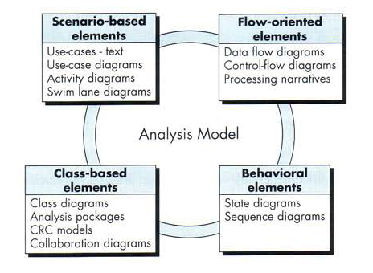
Elements of Analysis model
Use Case Diagrams
Data Flow Diagram
Class Diagram
Sequence Diagram

Slide 11
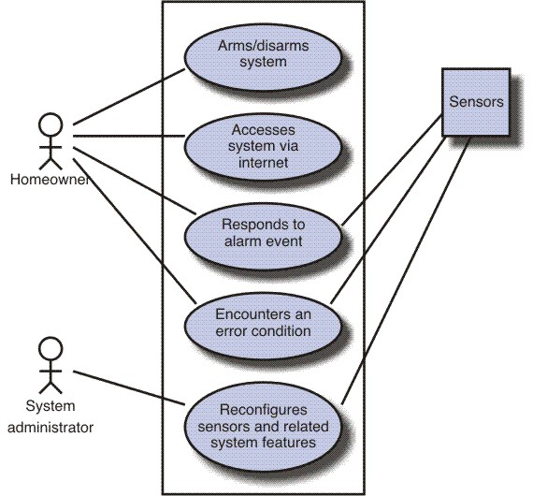
Scenario Based diagram
Scenario-based elements
Use-case—How external actors interact with the system (use-case diagrams; detailed templates)
Functional—How software functions are processed in the system (flow charts; activity diagrams)
Activity – can be represented at many diff. level of abstraction.

Slide 12
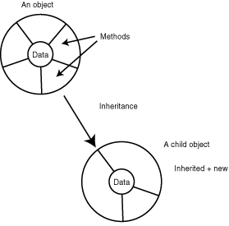
What is Object Orientation?

Slide 13
Encapsulation
Encapsulation is also known as information hiding concept.
The data and operations are combined into a single unit.
The only way to access data is through operations which are designed to operate on the data.
The data is not available to external world.
This concept may make the data safe and secure from external interventions.

Slide 14
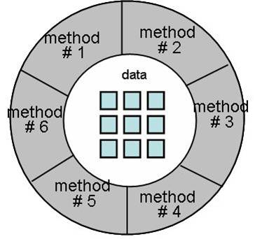
Encapsulation

Slide 15
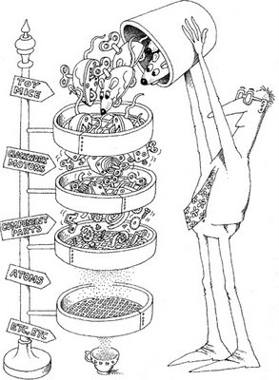
Inheritance
We may organize our knowledge in terms of hierarchy of categories.
All classes inherit information from the upper classes.
Each derived class inherits the attributes of its base class and this process is known as inheritance. In general, low level classes (known as subclasses or derived classes) inherit state and behaviour from their high level class (known as a super class or base class).

Slide 16
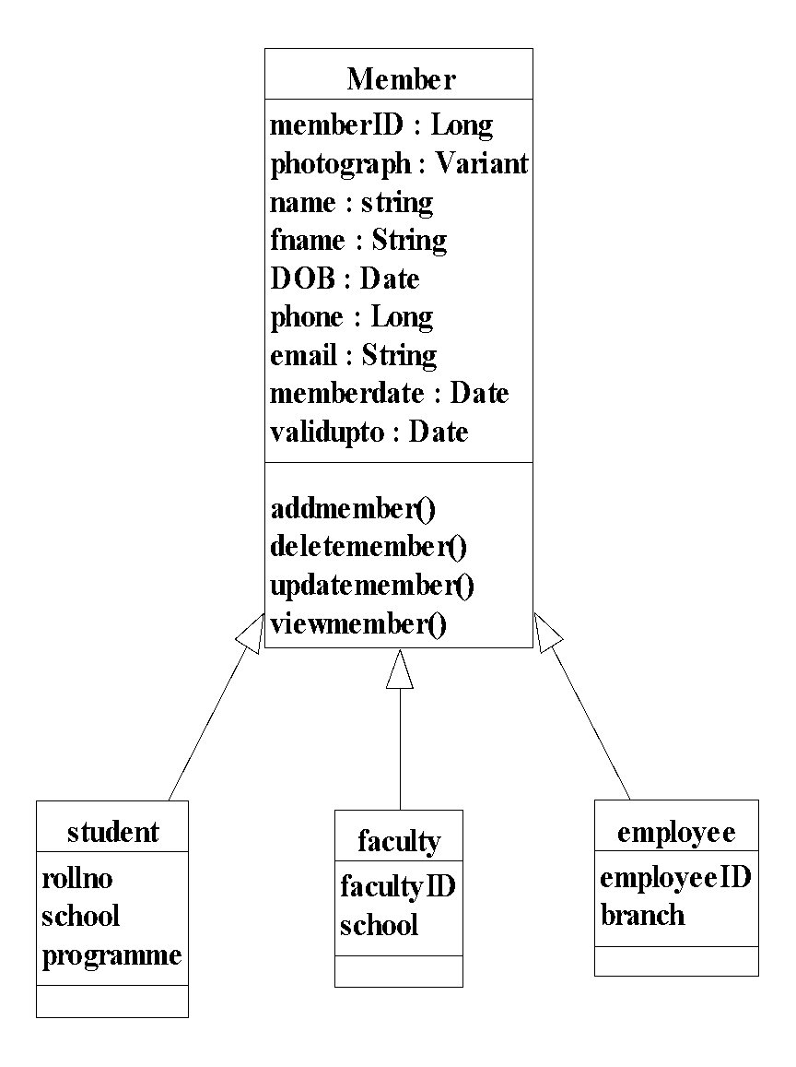

Slide 17
Inheritance
class Member
{
private:
long int memberID;
char photograph [300];
char name[50];
char fname [50];
Date DOB;
long int phone;
char email [60];
Date memberdate;
Date validupto;
public:
addmember();
deletemember();
updatemember();
viewmember();
};

Slide 18
Inheritance
class employee : public Member //publicly derived class
{
long int employeeID;
char branch[60];
};
class faculty : public Member //public inheritance
{
long int facultyID;
char school[100];
};
class student : public Member //public inheritance
{
long int rollno;
char school[100];
char programme[100];
};

Slide 19
Method
A ‘method’ is the sequence of steps (or set of operations) to be performed to fulfill the assigned task.
For example, four methods ‘addmember’, ‘deletemember’, ‘updatemember’, and ‘viewmember’ are implemented in Member class.
There may be many methods available for any task. It is the responsibility of receiver of the message to choose an appropriate method to complete task effectively & efficiently.

Slide 20
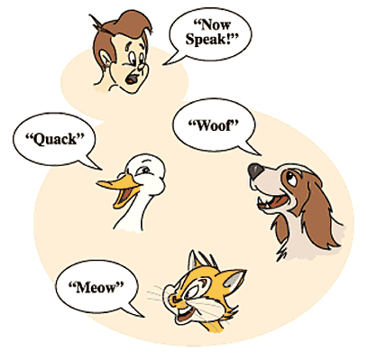
Polymorphism

Slide 21
Polymorphism
The dictionary meaning of polymorphism is “many forms”.
In the real world, the same operations may have different meanings in different situations.
Same message is sent to different objects irrespective of their class, but the responses of objects may be different.

Slide 22
Polymorphism
Polymorphism is considered to be an important concept of any object oriented programming languages.
As we all know, arithmetic operators such as +, =, - are used to operate on primary data types such as int, float etc.
We may overload these operators so that they may operate in the same way on objects (user defined data types) as they operate on primary data types.
Thus, the same operators will have multiple forms.

Slide 23
Class Diagram:
Class diagrams are the most common diagrams used in UML. Class diagram consists of classes, interfaces and associations.
Class diagram represents the object orientation of a system. So it is generally used for development purpose. This is the most widely used diagram at the time of system construction.

Slide 24
Classes & Objects
All book types may be combined to form a group called class.
All objects are instances of a class.
The class describes the structure of the instance which include behaviour and information.
Class
Book
Software
Engineering
Software
Testing
Software
Quality
Object1
Object2
Object3

Slide 25

Classes & Objects
Suppose there are 10 books in a library of same subject, language, publisher and author; but these books are distinguishable due to their own title and accession number.
All objects have unique identification like accession number in case of a book in the library. In a library, book, student, faculty, employee are the example of objects.

Slide 26
Classes & Objects
A set of objects with similar behaviour & information may constitute a class.
Hence, an object has a state (information) and it offers number of operations (behaviour) depending upon its class.

Slide 27
Classes & Objects
A class represents a template for several objects and describes how these objects are structured internally. Objects of the same class have the same definition both for their operations and for their information structures.
An instance is an object created from a class. The class describes the (behaviour & information) structure of the instance, which the current state of the instance is defined by the operations performed on the instance.
An attribute (or information / state) is a data value held by the object of a class.
Operations (or behaviour) are the functions which may be applied on a class.

Slide 28
Classes
ClassName
A class is a description of a set of objects that share the same attributes, operations, relationships, and semantics.
Graphically, a class is rendered as a rectangle, usually including its name, attributes, and operations in separate, designated compartments.
attributes
operations
Software Design (UML)

Slide 29
Class Names
ClassName
The name of the class is the only required tag in the graphical representation of a class. It always appears in the top-most compartment.
attributes
operations
Software Design (UML)

Slide 30
Class Attributes
Person
name : String
address : Address
birthdate : Date
ssn : Id
An attribute is a named property of a
class that describes the object being modeled.
In the class diagram, attributes appear in
the second compartment just below the
name-compartment.
Software Design (UML)

Slide 31
Class Attributes (Cont’d)
Person
Attributes are usually listed in the form:
attributeName : Type
A derived attribute is one that can be
computed from other attributes, but
doesn’t actually exist. For example,
a Person’s age can be computed from
his birth date. A derived attribute is
designated by a preceding ‘/’ as in:
/ age : Date
name : String
address : Address
birthdate : Date
/ age : Date
ssn : Id
Software Design (UML)

Slide 32
Class Attributes (Cont’d)
Person
+ name : String
# address : Address
# birthdate : Date
/ age : Date
- ssn : Id
Attributes can be:
+ public
# protected
- private
/ derived
Software Design (UML)

Slide 33
Class Operations
Person
name : String
address : Address
birthdate : Date
ssn : Id
eat
sleep
work
play
Operations describe the class behavior
and appear in the third compartment.
Software Design (UML)

Slide 34
Class Operations (Cont’d)
PhoneBook
newEntry (n : Name, a : Address, p : PhoneNumber, d : Description)
getPhone ( n : Name, a : Address) : PhoneNumber
You can specify an operation by stating its signature: listing the name, type, and default value of all parameters, and, in the case of functions, a return type.
Software Design (UML)

Slide 35
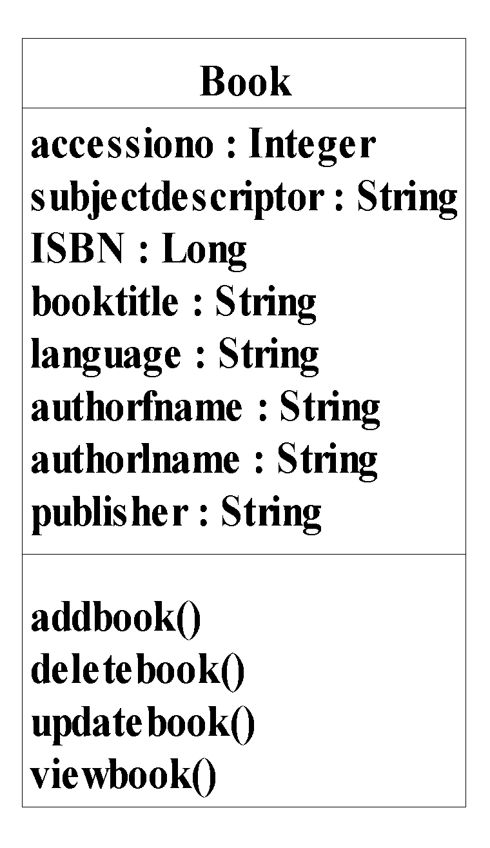
Classes & Objects
Class name
Attributes
Book Class
Operations

Slide 36
Class Responsibilities
A class may also include its responsibilities in a class diagram.
A responsibility is a contract or obligation of a class to perform a particular service.
SmokeAlarm
Responsibilities
-- sound alert and notify guard station
when smoke is detected.
-- indicate battery state
Software Design (UML)
Notes:
‹#›

Slide 37
Identification of Relationships
A system consists of classes and objects. The system model depicts the communication amongst classes.
The instances of a class communicate through sending messages.
For example, the book is issued after the issue book message is received by the issue book object.
Notes:
‹#›

Slide 38
Relationships
In UML, object interconnections (logical or physical), are
modeled as relationships.
There are three kinds of relationships in UML:
dependencies
generalizations
associations
Software Design (UML)

Slide 39
Identification of Relationships
Relationship | Description | Notation
Association | It provides structural connection between instances of classes.
Aggregation | It provides whole-part kind of relationship between classes.
Composition | It provides strong aggregation between classes.
Dependency | It signifies that changes in one class affect the other class.
Generalization | It signifies parent-child relationship amongst classes.
Notes:
‹#›

Slide 40
Identification of Relationships
Association
Association is a structural connection between classes. This type of relationship is mostly bidirectional. In another terms, the association relationship provides a link between different objects of the classes in the relationship.
Notes:
‹#›

Slide 41
Association Relationships
If two classes in a model need to communicate with each other, there must be link between them.
An association denotes that link.
Student
Instructor
Software Design (UML)

Slide 42
Identification of Relationships
Multiplicity can be shown as many (0..*), one or more (1..*), exactly one (1). Hence multiplicity is denoted as:
Minimum_value..maximum_value
Some commonly used multiplicity indicators are given below
1 One
0..* many
1..* one or more
0..1 zero or one
3..5 specific range (3, 4 or 5)

Slide 43
Association Relationships (Cont’d)
We can indicate the multiplicity of an association by adding multiplicity adornments to the line denoting the association.
The example indicates that a Student has one or more Instructors:
Student
Instructor
1..*
Software Design (UML)

Slide 44
Association Relationships (Cont’d)
The example indicates that every Instructor has one or more Students:
Student
Instructor
1..*
Software Design (UML)

Slide 45
Association Relationships (Cont’d)
We can also indicate the behavior of an object in an association (i.e., the role of an object) using rolenames.
teaches
learns from
Student
Instructor
1..*
1..*
Software Design (UML)

Slide 46
Association Relationships (Cont’d)
We can also name the association.
membership
Student
Team
1..*
1..*
Software Design (UML)

Slide 47
Association Relationships (Cont’d)
We can specify dual associations.
member of
Student
Team
1..*
1..*
1
president of
1..*
Software Design (UML)

Slide 48
Association Relationships (Cont’d)
We can constrain the association relationship by defining the navigability of the association. Here, a Router object requests services from a DNS object by sending messages to (invoking the operations of) the server. The direction of the association indicates that the server has no knowledge of the Router.
Router
DomainNameServer
Software Design (UML)

Slide 49
Association Relationships (Cont’d)
A class can have a self association.
next
LinkedListNode
previous
Software Design (UML)

Slide 50
Aggregation
We can model objects that contain other objects by way of special associations called aggregations and compositions.
An aggregation specifies a whole-part relationship between an aggregate (a whole) and a constituent part, where the part can exist independently from the aggregate. Aggregations are denoted by a hollow-diamond adornment on the association.
Car
Engine
Transmission
Software Design (UML)

Slide 51
Composition
A composition indicates a strong ownership and coincident lifetime of parts by the whole (i.e., they live and die as a whole). Compositions are denoted by a filled-diamond adornment on the association.
Window
Scrollbar
1
1
Titlebar
1
1
Menu
1
1 .. *
Software Design (UML)

Slide 52
Dependency Relationships
A dependency indicates a semantic relationship between two or
more elements. The dependency from CourseSchedule to Course exists because Course is used in both the add and remove operations of CourseSchedule.
CourseSchedule
Course
add(c : Course)
remove(c : Course)
Software Design (UML)

Slide 53
Identification of Relationships
Generalization
Generalization is a relationship between parent class and the child class. This relationship depicts inheritance relationships.
Generalization relation is also known as ‘is-a’ relationship. In this relationship the child inherits all the properties of its parents but vice versa is not true.

Slide 54
Generalization Relationships
Person
A generalization connects a subclass
to its superclass. It denotes an
inheritance of attributes and behavior
from the superclass to the subclass and
indicates a specialization in the subclass
of the more general superclass.
Student
Software Design (UML)

Slide 55
Generalization Relationships (Cont’d)
UML permits a class to inherit from multiple superclasses, although some programming languages (e.g., Java) do not permit multiple inheritance.
Student
Employee
TeachingAssistant
Software Design (UML)

Slide 56
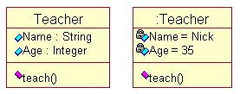
Classes & Objects

Slide 57

Messages
Objects communicate through passing messages.
A message is a request for performing an operation by some object in the system.
A message may consist of the identification of the target object, name of the requested operation and other relevant information for processing the request.
An object which originates a message is called the sender and the object which receives a message is called the receiver.

Slide 58
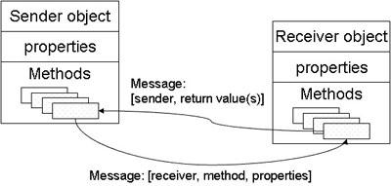
Message Exchange in Classes

Slide 59
Example: Order System
Order System of an application. So it describes a particular aspect of the entire application.
First of all Order and Customer are identified as the two elements of the system and they have a one to many relationship because a customer can have multiple orders.
We would keep Order class is an abstract class and it has two concrete classes (inheritance relationship) SpecialOrder and NormalOrder.
The two inherited classes have all the properties as the Order class. In addition they have additional functions like dispatch () and receive ().

Slide 60
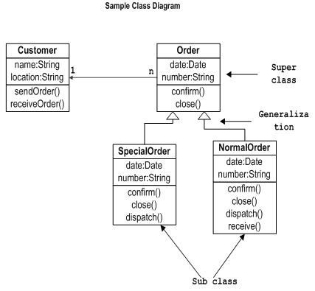

Slide 61
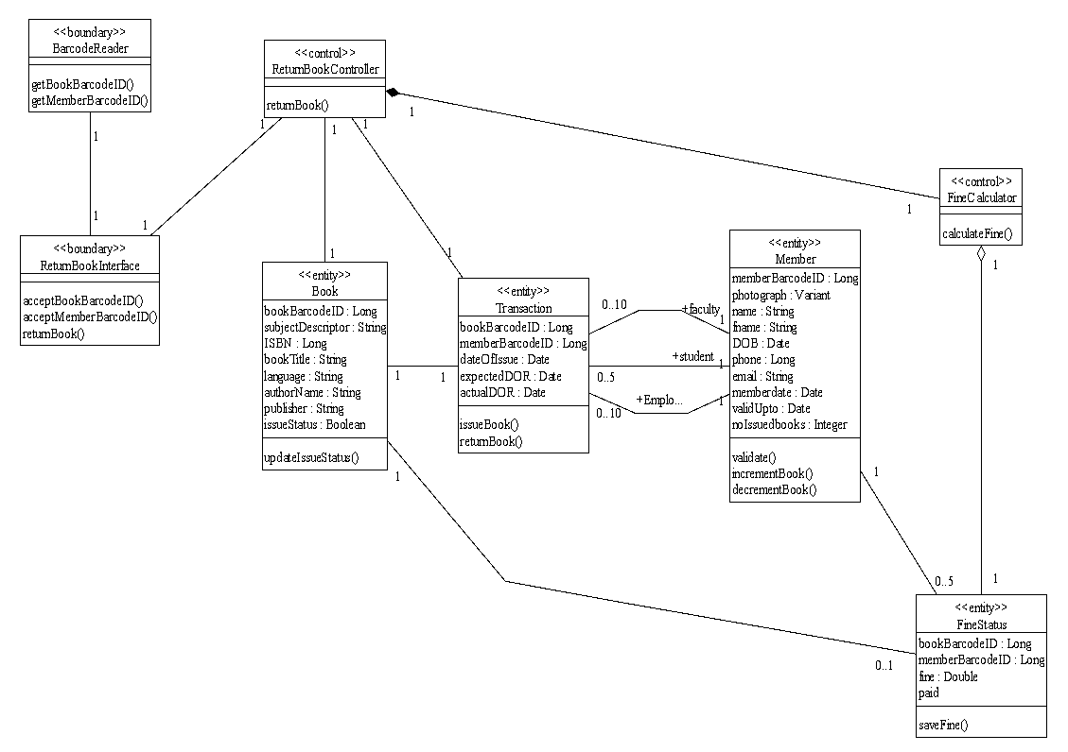

Slide 62
Object Diagram:
Object diagrams can be described as an instance of class diagram. So these diagrams are more close to real life scenarios where we implement a system.
Object diagrams are a set of objects and their relationships just like class diagrams and also represent the static view of the system.
The usage of object diagrams is similar to class diagrams but they are used to build prototype of a system from practical perspective.

Slide 63
Object Diagram…
We can have unlimited number of instances which are unique in nature. So only those instances are considered which are having impact on the system.
single object diagram cannot capture all the necessary instances or rather cannot specify all objects of a system. So the solution is:
First, analyze the system and decide which instances are having important data and association.
Second, consider only those instances which will cover the functionality.

Slide 64
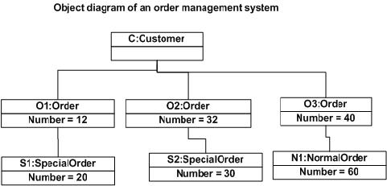

Slide 65
State Representation
2 diff. characteristics should be considered.
Passive State
Active State
Passive state is simply the current status of all of an object’s attributes.
Ex. Player – class
current position and orientation – attributes.
Active State is current state of the object as it undergoes a continuing transformation or processing.
Ex. Player – class
active state – moving, injured, trapped, lost etc.
An event must occur to force an object to make a transition from one active state to another.

Slide 66
State diagram for analysis classes
UML state diagram that represents active states for each class and events that causes changes between these active state.

Slide 67
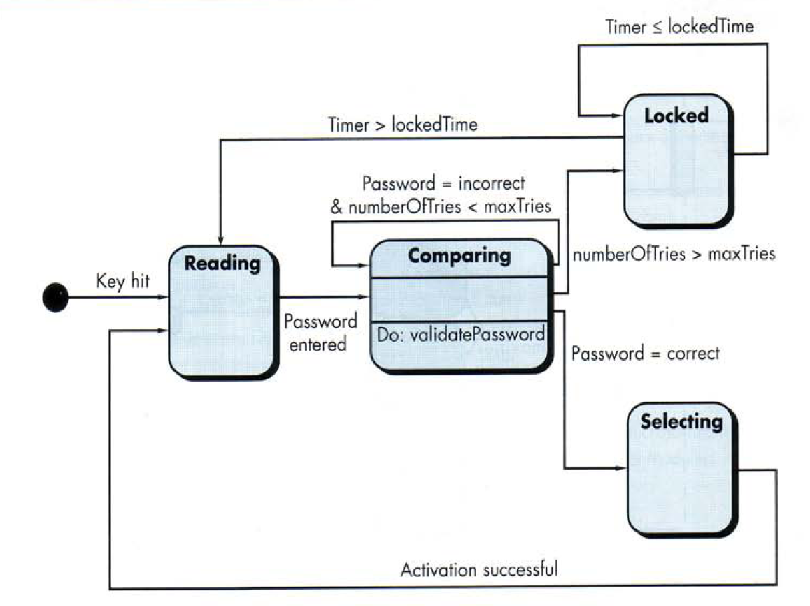

Slide 68
An action occurs concurrently with the state transition or as a sequence of it and generally involves one or more operations of the object.

Slide 69
Sequence diagram
It indicates how events cause transitions from object to object .
Once event have identified by examining a use-cases, the modeler creates a sequence diagram.
It representation of how events cause flow from one objects to another as function of time.
Its shorthand version of use-case diagram that represent key classes and the events that cause behavior to flow from class to class.
System objects and events will help in creation of effective design.

Slide 70
Mechanics of Structured Analysis
It all about
Entity relationship diagram (ERD)
Data flow diagram (DFD)
State transition diagram (STD)

Slide 71
ERD
Creating ERD diagram:
Customers are asked to list the “things” that the application or business process addresses
The analyst and customer defined connection exist between data object and other objects (if any)
Wherever a connection exists, the analyst and the customer create one or more object/relationship pairs.
For each object/relationship pair, cardinality and modality are explored.
Steps 2 through 4 are continued iteratively until all object/relationships have been defined.
The attributes of each entity are defined.
An entity relationship diagram is formalized and reviewed.
Steps 1 through 7 are repeated until data modeling is complete.

Slide 72
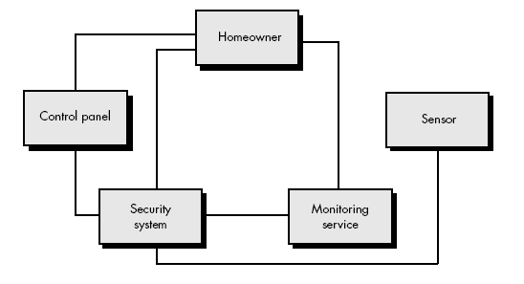
Example

Slide 73
Safe-Home Security System:
Step 1: Identified things
homeowner
control panel
sensors
security system
monitoring service
Step 2: one or more object/relationship pairs are identified for each connection.
Step 3: security system monitors sensor
security system enables/disables sensor
security system tests sensor
security system programs sensor
Step 4: Cardinality and modality
The cardinality between security system and sensor is one to many.
Modality of security system (mandatory) and sensor(mandatory)
Step 5: repeat 2 to 4 for all objects.
Step 6: Each object is studied to determine its attributes.
For example: sensor -- sensor type, internal identification number, zone location, and alarm level.

Slide 74
Data dictionary
Data dictionary is an organized listing of all data elements that are pertinent to the system, with precise, rigorous definitions so that both user and system analyst will have a common understanding of inputs, outputs, components of stores and [even] intermediate calculations.
Data dictionary is always implemented as part of a CASE "structured analysis and design tool.“
Most contain following information :
Name —the primary name of the data or control item, the data store or an external entity.
Alias —other names used for the first entry.
Where-used/how-used —a listing of the processes that use the data or control item and how it is used (e.g., input to the process, output from the process, as a store, as an external entity.

Slide 75
Data dictionary
Content description—a notation for representing content.
Supplementary information—other information about data types, preset values (if known), restrictions or limitations, and so forth.

Slide 76
Data dictionary
Once a data object or control item name and its aliases are entered into the data dictionary, consistency in naming can be enforced. That is, if an analysis team member decides to name a newly derived data item xyz, but xyz is already in the dictionary, the CASE tool supporting the dictionary posts a warning to indicate duplicate names.
“Where-used/how-used” information is recorded automatically from the flow models. When a dictionary entry is created, the CASE tool scans DFDs and CFDs to determine which processes use the data or control information and how it is used.

Slide 77
Data dictionary
For large projects, it is often quite difficult to determine the impact of a change. Many a software engineer has asked, "Where is this data object used? What else will have to change if we modify it? What will the overall impact of the change be?" Because the data dictionary can be treated as a database,

Slide 78
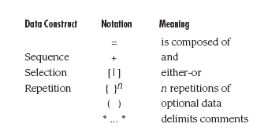
The notation used to develop a content description is noted in the following table:

Slide 79
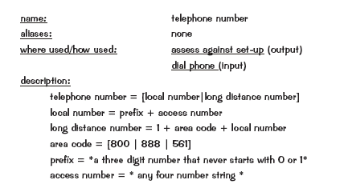
Data dictionary example

